Slide 1
Test 1 sample questions and discussions

Slide 2
Test 1
Available next week on wed Feb 17th.
2 hours
Timed once you start.
Mix of multiple choice questions and file upload (excel, code).

Slide 3
Utility Valuation

Slide 4

Utility valuation
Suppose a fair coin is flipped and you get $100 if it shows up heads and $0 if it shows tails.
Your utility function is U(x) = √x.
What would you pay for this game?
If your friend has a utility function given by $V\left(x\right)= \sqrt[3]{x}$ what would be their price. Who is more risk averse?
What if $U\left(x\right)=x$or $U\left(x\right)=x^{2}$ ?

Slide 5
Risk aversion, St. Petersburg paradox, John Von Neumann
Risk aversion and utility functions U
Personality is risk averse if utility function is concave
Personality is risk neutral if utility function is linear
Personality is risk loving if utility function is convex
Is your utility function concave?

Slide 6
Risk Neutral Valuation

Slide 7
Option valuation
Assume a stock is trading at $96. 1-year later the price will either be $102 or $92, each with a chance of 50%. The risk-free rate is 0%. A 1-year call option has a strike of $100. What is the price of the call option under these restrictive assumptions?

Slide 8
Suppose C = $1(remember stock = 96, r = 0%)
Sell 10 Calls (to someone) (Get $10)
Borrow $182 (Now you have $192) at r = 0%
Buy 2 Stocks (Pay 96 x 2 = 192)
Stay on it…
What happens at year end?

Slide 9
Risk Free Payoffs!
1-year later Stock | Sold 10 calls (strike 100) | Bought 2 stocks | RETURN Borrowed 182 | Total Gain/Loss
102 | -20 | 204 | -182 | 2
92 | 0 | 184 | -182 | 2

Slide 10
What is the market? Risk averse?
The market risk aversion is a weighted average of the risk aversion of all its participants.
Hence market must be risk averse with a concave utility function.
This utility function is not computable.
Without knowing the utility function, you cannot solve binomial pricing problems! These are ill posed problems. You do not have the information to solve the problem.
…unless…

Slide 11
Replication
The delta hedge shows what instruments replicates the call!
Now you can bypass the utility function!

Slide 12
Probability and risk aversion are not needed for computing the price!!!!
Note: nowhere in the replication do we need the probabilities!
This is a probability free construction.
Hence both the probability distribution and the risk aversion measure are not required!!

Slide 13
Return of probability
But we like probability.
Assume the simplest utility function
Imply probability and operate normally…!
This is the risk neutral valuation.
Why is it called risk neutral?

Slide 14
Von Neumann Chart
Personality | Discounted Exp Vs. Market Price | Utility | Stochastic Process | Sharpe ratio
Risk Averse
Risk Neutral
Risk Loving

Slide 15
Von Neumann Chart
Personality | Discounted Exp (DE) Vs. Market Price (MP) | Utility | Stochastic Process | Sharpe ratio
Risk Averse | MP < DE | Concave | Super-martingale | positive
Risk Neutral | MP = DE | linear | martingale | 0
Risk Loving | MP > DE | convex | sub-martingale | negative

Slide 16
Put Option valuation
Assume a stock is trading at $96. 1-year later the price will either be $102 or $92, each with a chance of 50%. The risk-free rate is 0%. A 1-year put option has a strike of $100. What is the price of the put option under these restrictive assumptions?

Slide 17
Forward contract valuation
Assume a stock is trading at $96. 1-year later the price will either be $102 or $92, each with a chance of 50%. The risk-free rate is 0%. A 1-year forward contract has a strike of $100. What is the price of the forward contract under these restrictive assumptions?

Slide 18
Cox Ross Rubinstein

Slide 19
1. 1-step tree with vol
Stock is at 100. The volatility is at 40%. Risk free rate is at 5%. Price an at the money 1 year European call option using a 1 step tree. Use CRR procedure to get the tree.
Now price an at-the-money European put option.

Slide 20
2. Use a 2 step tree
Stock is at 100. The volatility is at 40%. Risk free rate is at 5%. Price an at the money 1 year European call option using a 2 step tree. Use the CRR procedure.
Now price an at-the-money European put option.

Slide 21
3. American Option Pricing
Same problem with American call option
Same problem with American put option

Slide 22
Early exercise of American options
Explain why an American call on a non-dividend paying stock is never exercised early.
Why does a similar story not work for an American put option?

Slide 23
4. Crr with dividends
Stock is at 100. The volatility is at 40%. Risk free rate is at 5%. The stock pays a dividend of 3% continuously. Price an at the money 1-year European call option using a 2 step tree. Use the CRR procedure.
Now price an at-the-money European put option.
Does an American call option get exercised early? What is the price? What if the dividend is increased?

Slide 24
5. Delta Hedge position
From the 2-step tree solution to European and American call options explain how you would delta hedge a short position in the options along each path to expiration. Assume no dividends.
Repeat for put options.

Slide 25
6. Crr with dividends: Options on futures
Price an American put option on a futures contract. The strike price and the futures price are $50, the risk-free rate is 10%, the time to maturity is 6 months, and the volatility is 40% per annum. Use a 2-step tree.
For options on futures use dividend to be the risk free rate.

Slide 26
7. Crr with dividends: Options on currencies
Calculate the value of 1-year American call option to buy 100,000 units of a foreign currency using a 2-step binomial tree. The current exchange rate is 0.79 and the strike price is 0.80 (both expressed as dollars per unit of the foreign currency). The volatility of the exchange rate is 12% per annum. The domestic and foreign risk-free rates are 2% and 5%, respectively.
The dividend is the foreign risk-free rate.

Slide 27
8. Other Trees! CRR is not the only way to create trees
Stock is at 100. Risk free rate is 5%. Price an at-the-money call option using the following effects!
Create a 2-step tree with a momentum on the upside.
Create a 2-step tree with mild mean reversion.
Log-normal tree. Assume volatility is 40%.

Slide 28
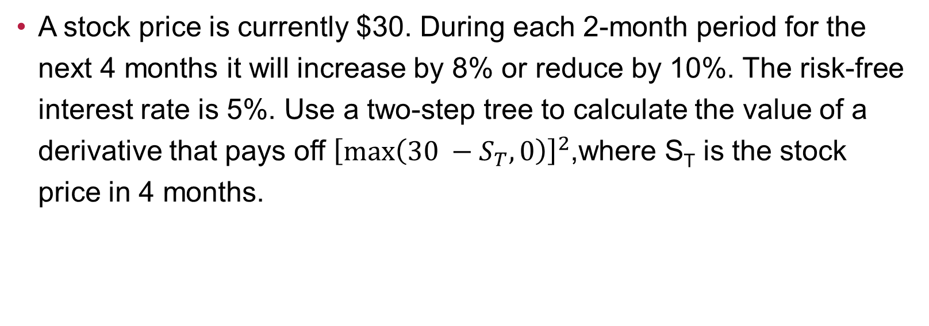
9. Non-standard payoffs
A stock price is currently $30. During each 2-month period for the next 4 months it will increase by 8% or reduce by 10%. The risk-free interest rate is 5%. Use a two-step tree to calculate the value of a derivative that pays off ${\left[\max\left(30 −S_{T}, 0\right)\right]}^{2}$,where S_{T} is the stock price in 4 months.

Slide 29
10. P&L Diagrams
The price of a stock is $40. The price of a 1-year European put option on the stock with a
strike price of $30 is quoted as $7 and the price of a 1-year European call option on the
stock with a strike price of $50 is quoted as $5. Suppose that an investor buys 100 shares,
shorts 100 call options, and buys 100 put options. Draw a diagram illustrating how the
investor’s profit or loss varies with the stock price over the next year. How does your
answer change if the investor buys 100 shares, shorts 200 call options, and buys 200 put
options?

Slide 30
11. Pricing bounds
Consider three strike prices K1, K2 and K3 in increasing order.
Which is more expensive, call(K1) or call(K2), all else equal?
Which is more expensive, put(K1) or put(K2), all else equal?
What is the relationship between the prices of call(K1), call(K2) and call(K3), all else equal?

Slide 31
12. Arbitrage from price data of options
Can you find arbitrage in the following option price data?
Call | S=100; r=1%;T=1 | Put
Price | Strike | Price
10 | 100 | 8

Slide 32
13. Arbitrage from price data of options
Can you find arbitrage in the following option price data?
Calls on TTR | T = 1 year
Price ($) | Strike ($)
4 | 10
3.5 | 15
2 | 20

